Slide 1


Switched Teleoperation-Autonomous Control for Human-Robot Cooperation using a Quadrupedal Mobile Manipulator
Supervisor: Prof. Paolo Rocco
Co-Supervisor: Prof. Marco Hutter
Alberto Giammarino 918085
School of Industrial and Information Engineering Master of Science – Mechanical Engineering
Academic Year 2019-2020

Slide 2
Outline
Problem Statement
Autonomous Human-Robot Cooperation
Switched Teleoperation-Autonomous Control
Conclusions and Future Works

Slide 3
Outline
Problem Statement
Autonomous Human-Robot Cooperation
Switched Teleoperation-Autonomous Control
Conclusions and Future Works

Slide 4

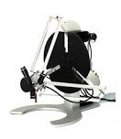
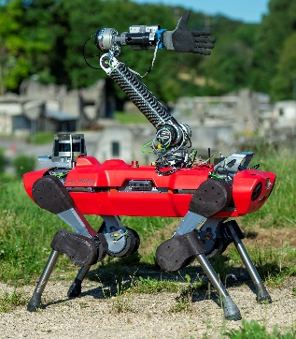
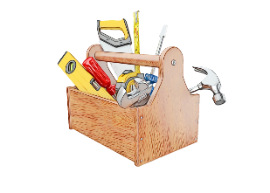
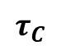
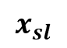
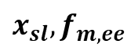
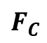
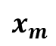
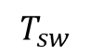
Problem Statement
$$x_{m}$$
Master controller
Comm. channel
Slave controller
$$T_{sw}$$
$$x_{sl}$$
$$F_{C}$$
Scope: shared autonomy framework in a specific scenario
Motivation: mutual improvement
Assumption: Use existing Teleoperation Framework
Problems Faced:
Autonomous Human-Robot Cooperation
Autonomous-Teleoperation Switches
$$τ_{C}$$
$$x_{sl}, f_{m,ee}$$
Autonomous controller

Slide 5
Outline
Problem Statement
Autonomous Human-Robot Cooperation
Switched Teleoperation-Autonomous Control
Conclusions and Future Works

Slide 6
Autonomous Human-Robot Cooperation
$$x_{m}$$
Master controller
Comm. channel
Slave controller
$$T_{sw}$$
$$x_{sl}$$
$$F_{C}$$
$$τ_{C}$$
$$x_{sl}, f_{m,ee}$$
Autonomous controller

Slide 7
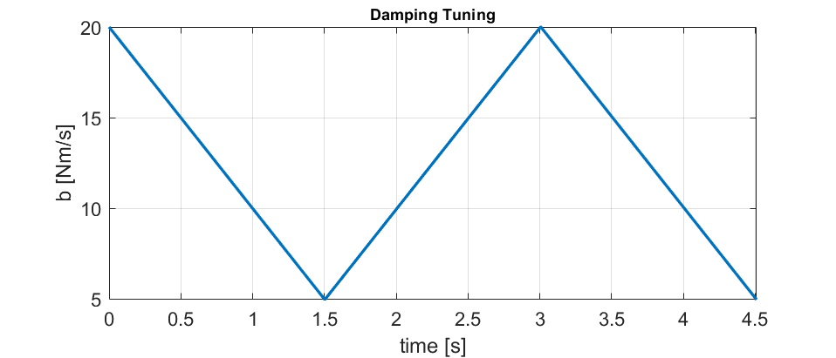
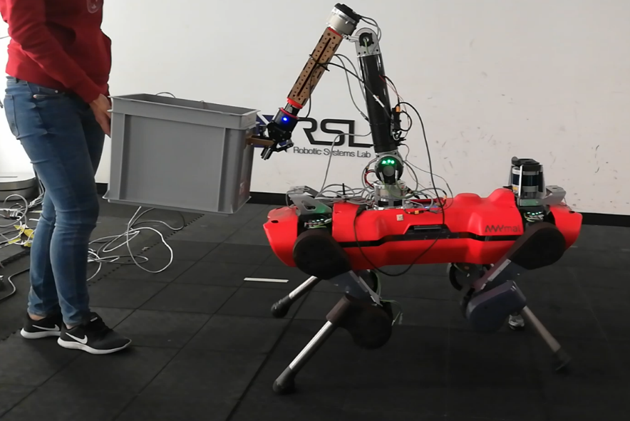
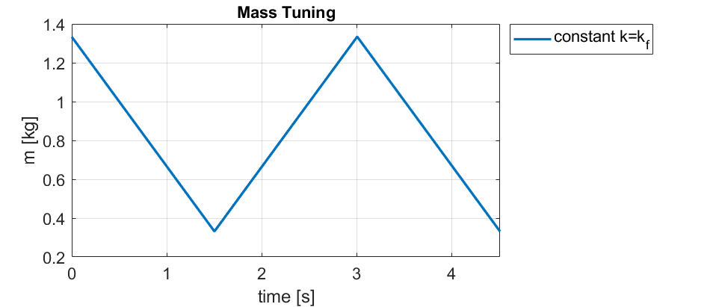
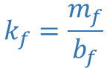
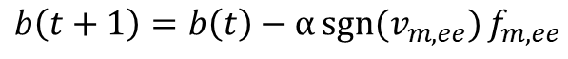
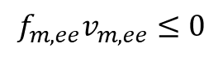
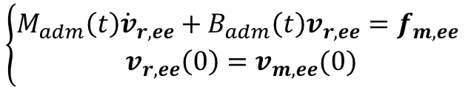
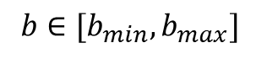
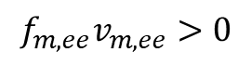
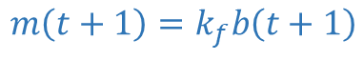
Autonomous Human-Robot Cooperation Human Follower Model
FTS
Assumptions:
No vision systems
Roles assigned
Only translations allowed
Human Follower Model
Intention recognition Leader
Acceleration Intention
Deceleration Intention
Dynamic Parameters Modulation
Damping
Mass
$$\left\{\begin{aligned}M_{adm}\left(t\right){\dot{v}}_{r,ee}+B_{adm}\left(t\right)v_{r,ee}=f_{m,ee} \\ v_{r,ee}\left(0\right)=v_{m,ee}(0)\end{aligned}\right.$$
$$f_{m,ee}v_{m,ee}>0$$
$$f_{m,ee}v_{m,ee}≤0$$
LEADER
FOLLOWER
$$b\left(t+1\right)=b\left(t\right)−α\operatorname{sgn}{(v_{m,ee})}f_{m,ee}$$
$b∈[b_{min}, b_{max}]$
$$m\left(t+1\right)=k_{f}b\left(t+1\right)$$
$$k_{f}=\frac{m_{f}}{b_{f}}$$
Notes:
FDD: First Deceleration Damping
Maybe add a plot especially for the mass modulation

Slide 8
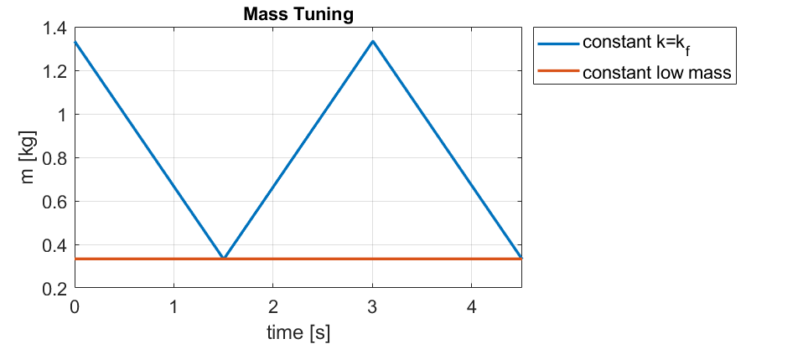

Autonomous Human-Robot Cooperation Human Follower Model
Assumptions:
No vision systems
Roles assigned
Only translations allowed
Human Follower Model
Intention recognition Leader
Acceleration Intention
Deceleration Intention
Dynamic Parameters Modulation
Damping
Mass
$$\left\{\begin{aligned}M_{adm}\left(t\right){\dot{v}}_{r,ee}+B_{adm}\left(t\right)v_{r,ee}=f_{m,ee} \\ v_{r,ee}\left(0\right)=v_{m,ee}(0)\end{aligned}\right.$$
$$f_{m,ee}v_{m,ee}>0$$
$$f_{m,ee}v_{m,ee}≤0$$
$$b\left(t+1\right)=b\left(t\right)−α\operatorname{sgn}{(v_{m,ee})}f_{m,ee}$$
$b∈[b_{min}, b_{max}]$
$$m\left(t+1\right)=k_{f}b\left(t+1\right)$$
$$k_{f}=\frac{m_{f}}{b_{f}}$$
$$m\left(t\right)=m_{min}=const$$
Notes:
FDD: First Deceleration Damping
Maybe add a plot especially for the mass modulation

Slide 9
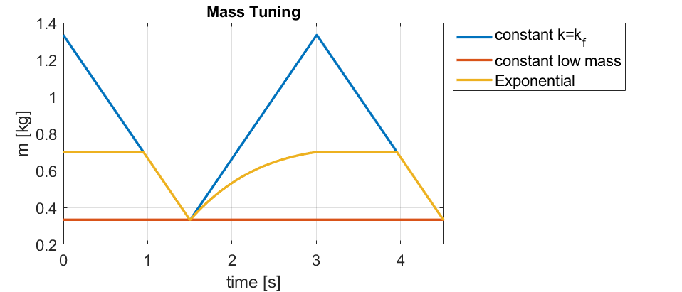

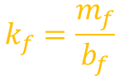
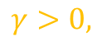
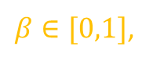
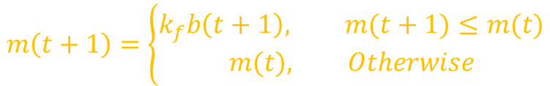
Autonomous Human-Robot Cooperation Human Follower Model
Assumptions:
No vision systems
Roles assigned
Only translations allowed
Human Follower Model
Intention recognition Leader
Acceleration Intention
Deceleration Intention
Dynamic Parameters Modulation
Damping
Mass
Acceleration
Deceleration
$$\left\{\begin{aligned}M_{adm}\left(t\right){\dot{v}}_{r,ee}+B_{adm}\left(t\right)v_{r,ee}=f_{m,ee} \\ v_{r,ee}\left(0\right)=v_{m,ee}(0)\end{aligned}\right.$$
$$f_{m,ee}v_{m,ee}>0$$
$$f_{m,ee}v_{m,ee}≤0$$
$$b\left(t+1\right)=b\left(t\right)−α\operatorname{sgn}{(v_{m,ee})}f_{m,ee}$$
$b∈[b_{min}, b_{max}]$
$$m\left(t+1\right)=\left\{\begin{aligned}k_{f}b\left(t+1\right), m(t+1)≤m(t) \\ &m(t), Otherwise\end{aligned}\right.$$
$$k_{f}=\frac{m_{f}}{b_{f}}$$
$$m\left(t+1\right)=k_{f}b\left(t+1\right)\{1−β\left[1−e^{−γ\left[b\left(t+1\right)−b_{0}\right]}\right]\}$$
$β∈[0,1]$,
$$γ>0,$$
$$b_{0}$$
FDD
Notes:
FDD: First Deceleration Damping
Maybe add a plot especially for the mass modulation

Slide 10
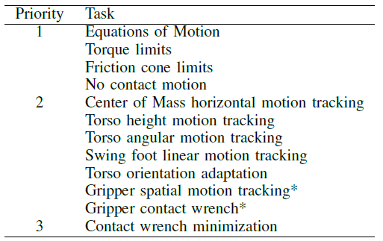
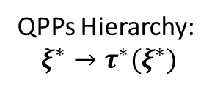
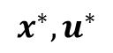
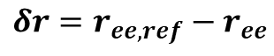
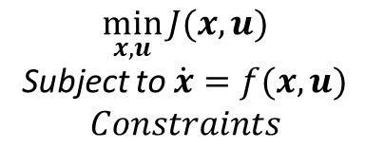
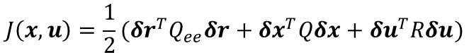
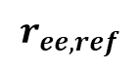
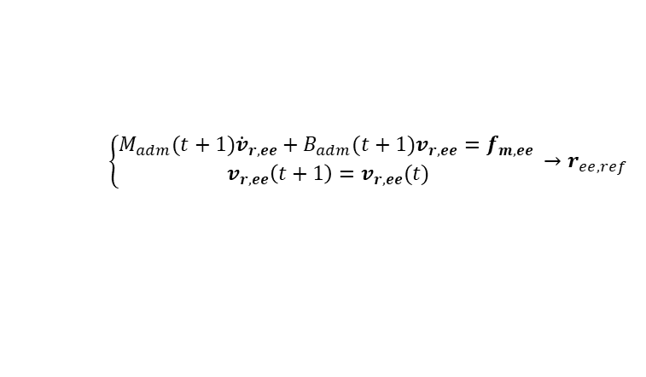
Autonomous Human-Robot Cooperation Robot Controller
High-Level Planner
$$r_{ee,ref}$$
Motion Planner (MPC)
$$x^{∗},u^{∗}$$
Whole-Body Controller
$$\min_{x,u}{J(x,u)}$$
Subject to $\dot{x}=f(x,u)$
$$Constraints$$
QPPs Hierarchy:
$$ξ^{∗}→τ^{∗}(ξ^{∗})$$
$$f_{m,ee}v_{m,ee}>?0→b\left(t+1\right),m(t+1)$$
$$\left\{\begin{aligned}M_{adm}(t+1){\dot{v}}_{r,ee}+B_{adm}(t+1)v_{r,ee}=f_{m,ee} \\ v_{r,ee}\left(t+1\right)=v_{r,ee}(t)\end{aligned}→r_{ee,ref} \right.$$
$$J\left(x,u\right)=\frac{1}{2}(δr^{T}Q_{ee}δr+δx^{T}Qδx+δu^{T}Rδu)$$
$$δr=r_{ee,ref}−r_{ee}$$
Notes:
Here erase the useless part, maybe don’t mention the MPC design but just talk about the design I used (motivate as natural choice since an admittance controller is designed in this way)

Slide 11
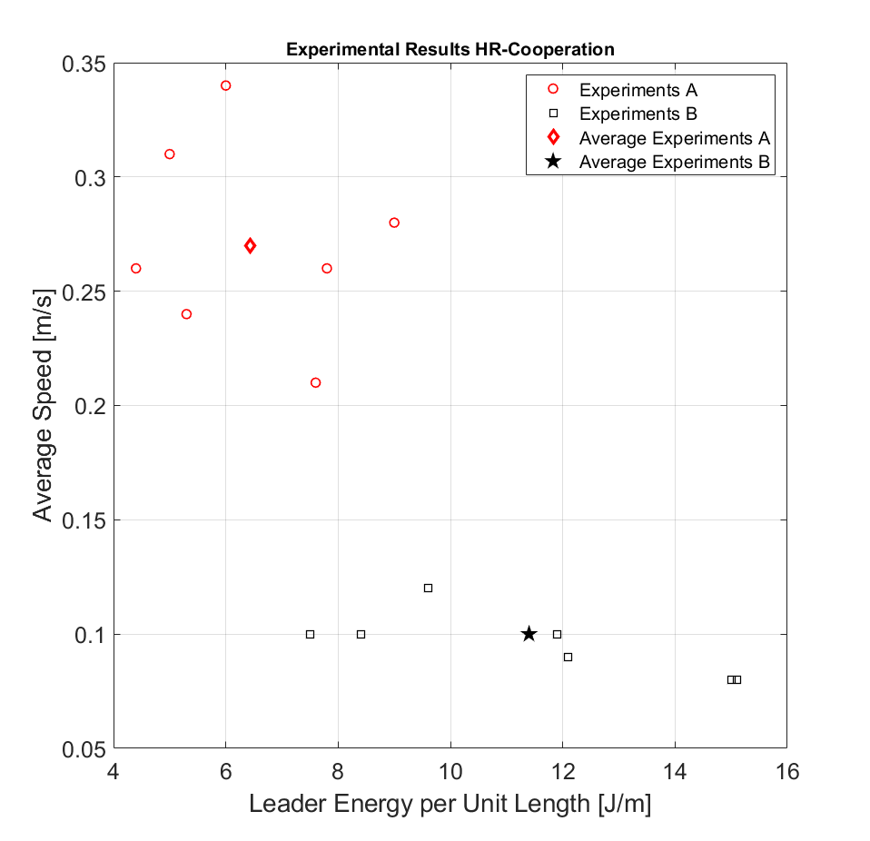
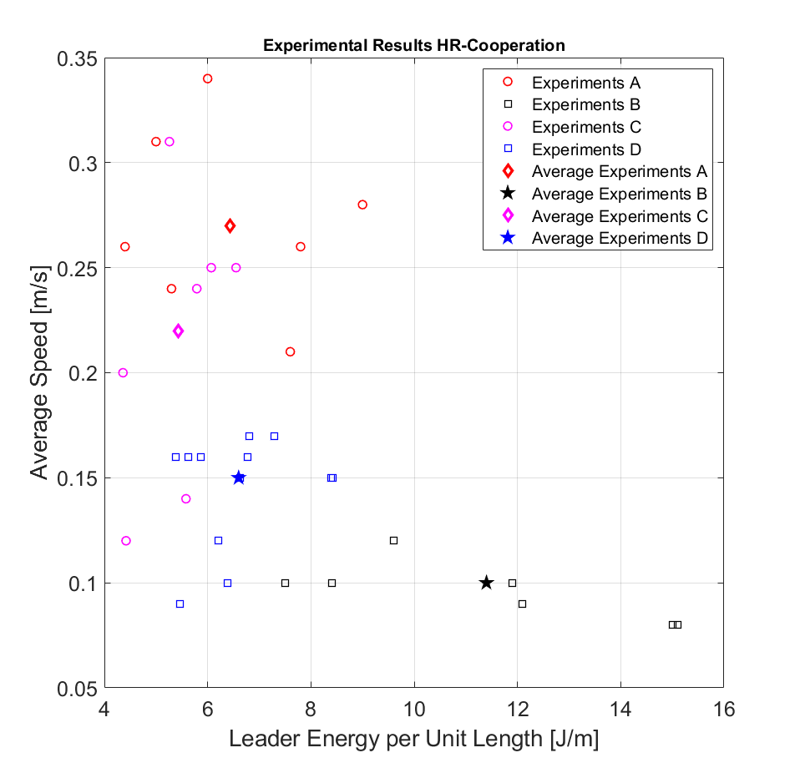
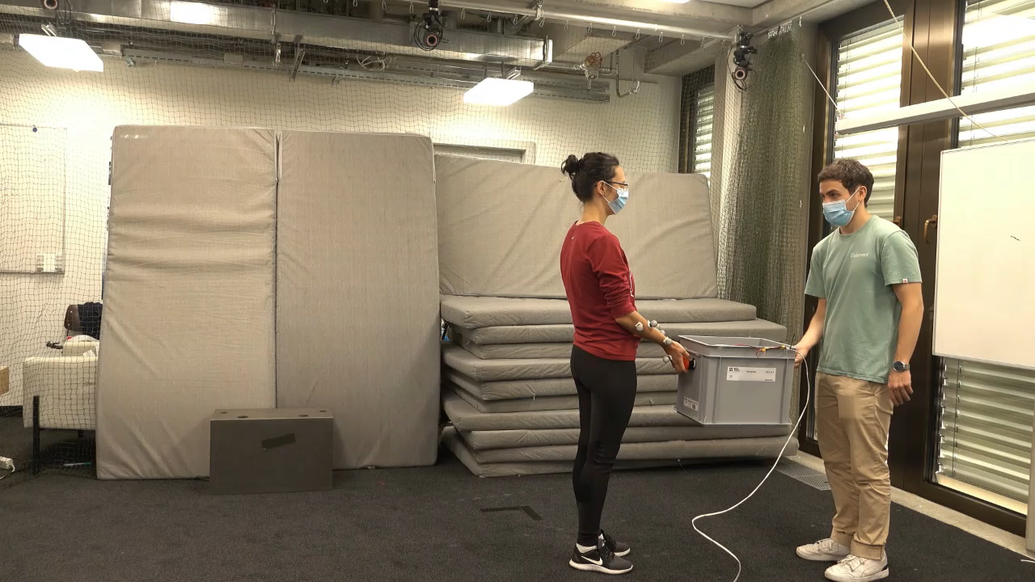
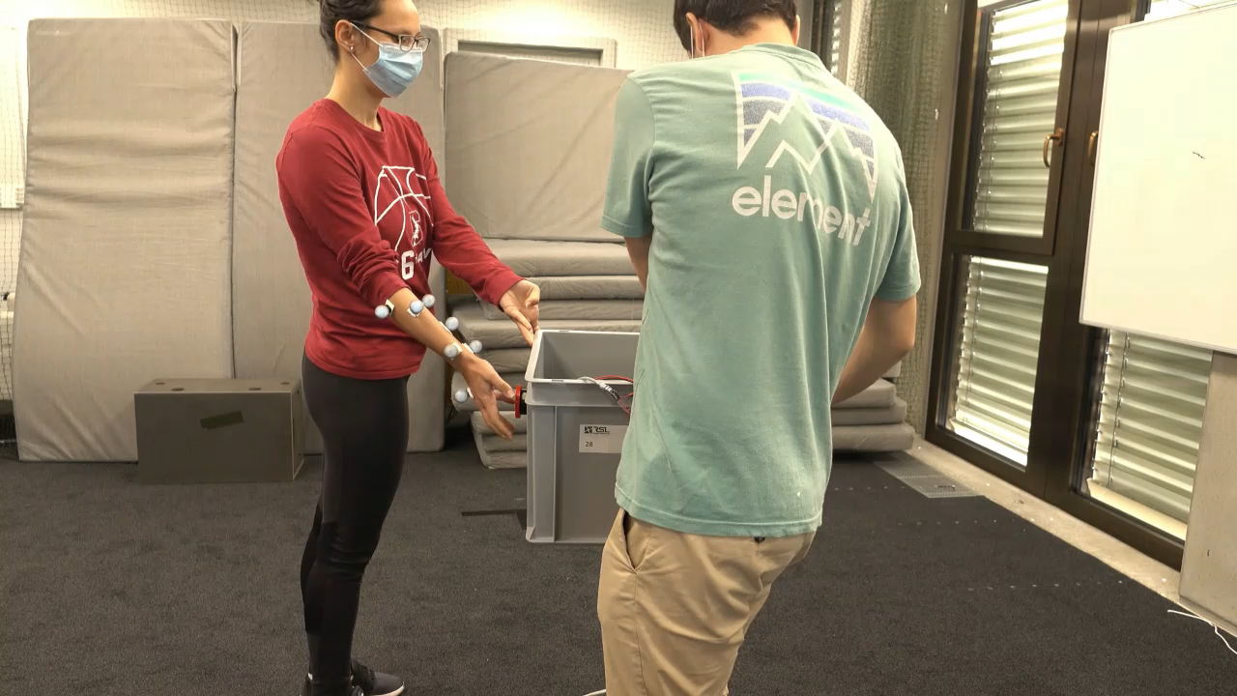
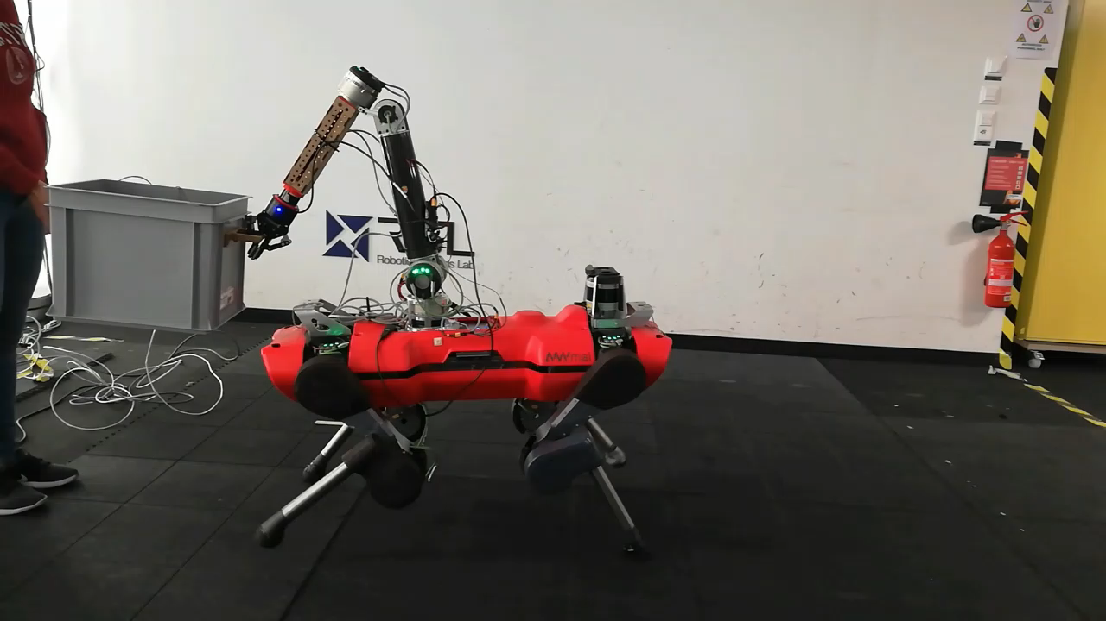
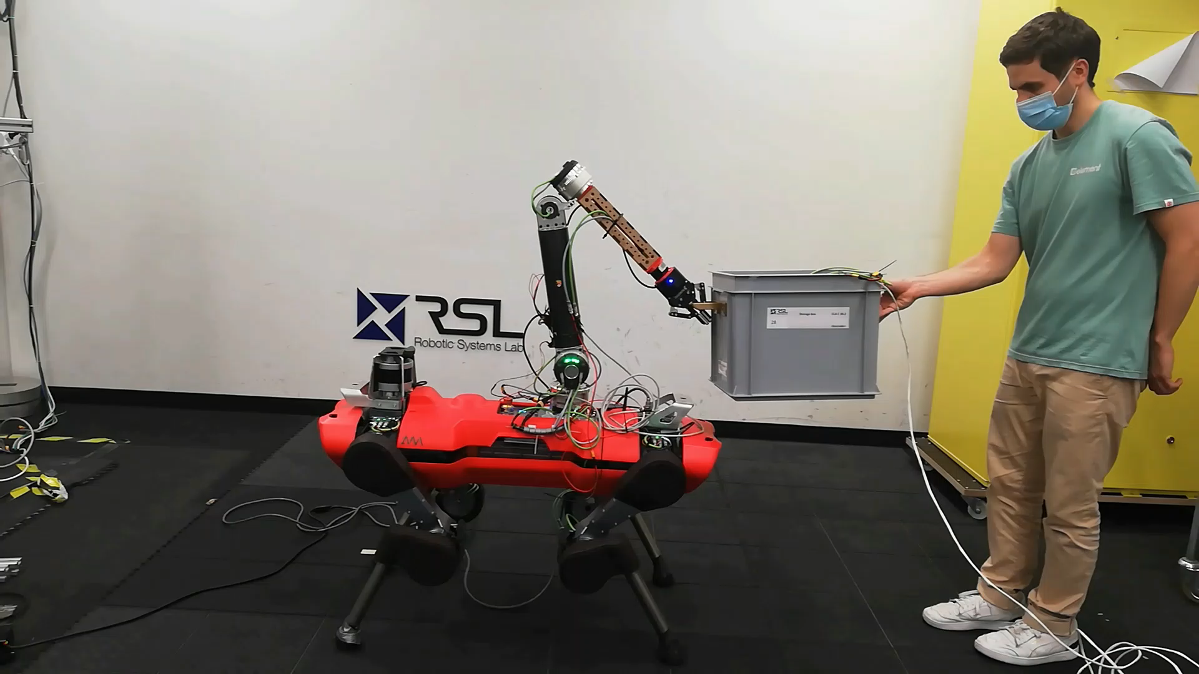
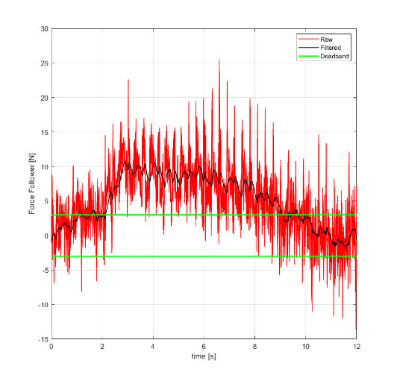
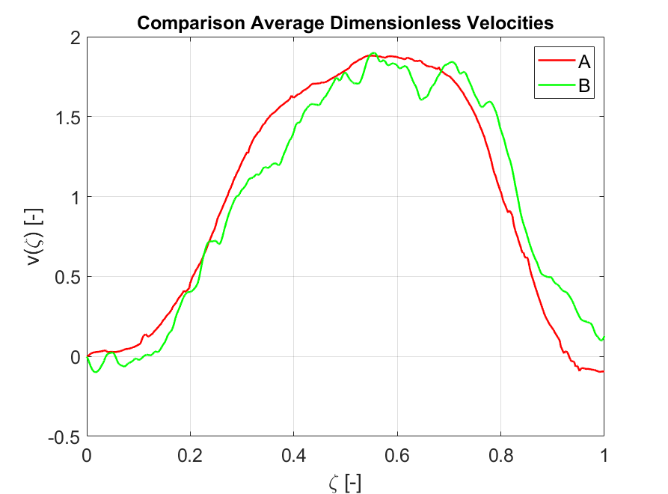
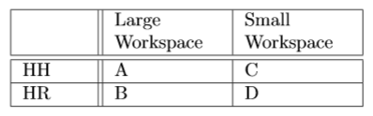
Autonomous Human-Robot Cooperation Experiments Results
Large Workspace
Small Workspace
Experiment Setup
Leader
Follower
Pos/Vel Follower
Interaction Forces
Evaluation Metrics
Average Task Speed
Leader Effort
Task Shape
HH
HR

Slide 12
Outline
Problem Statement
Autonomous Human-Robot Cooperation
Switched Teleoperation-Autonomous Control
Conclusions and Future Works

Slide 13
Switched Teleoperation-Autonomous Control
$$x_{m}$$
Master controller
Comm. channel
Slave controller
$$T_{sw}$$
$$x_{sl}$$
$$F_{C}$$
$$τ_{C}$$
$$x_{sl}, f_{m,ee}$$
Autonomous controller

Slide 14
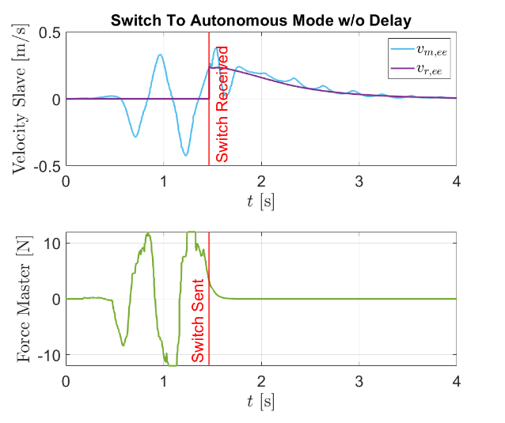
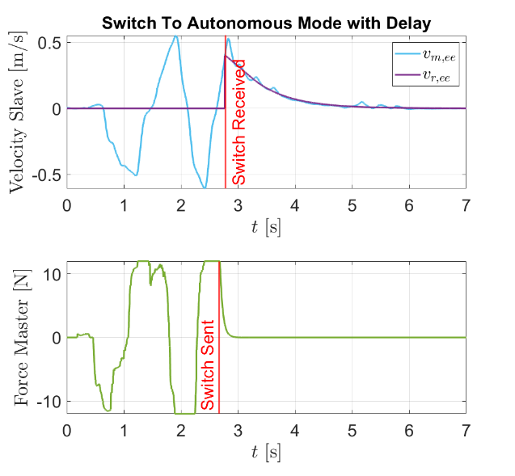
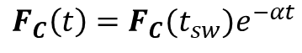
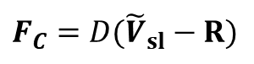
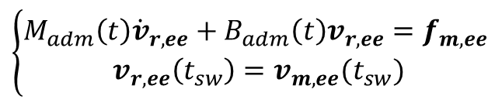
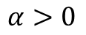
Switched Teleoperation-Autonomous Control Switch to Autonomous
Switch To Autonomous
Master side:
$$F_{C}=D({\tilde{V}}_{sl}−R)$$
$$F_{C}\left(t\right)=F_{C}(t_{sw})e^{−αt}$$
$$α>0$$
Slave side:
$$\left\{\begin{aligned}M_{adm}\left(t\right){\dot{v}}_{r,ee}+B_{adm}\left(t\right)v_{r,ee}=f_{m,ee} \\ v_{r,ee}\left(t_{sw}\right)=v_{m,ee}(t_{sw})\end{aligned}\right.$$

Slide 15
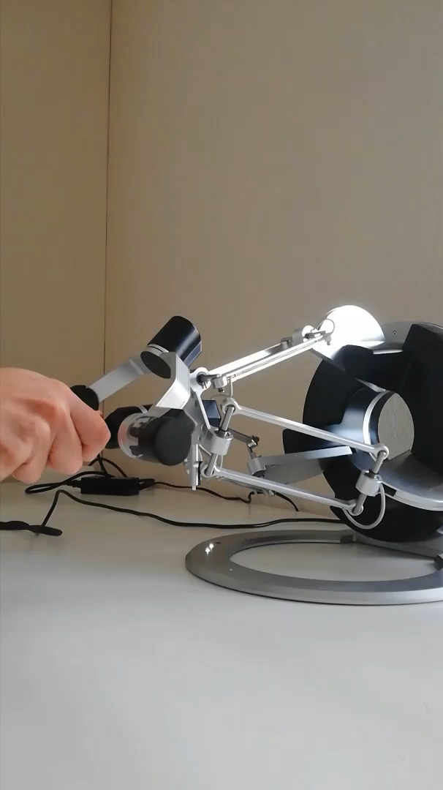
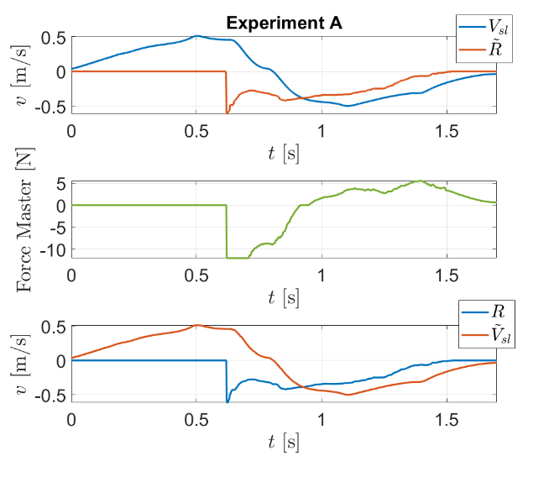








Switched Teleoperation-Autonomous Control Switch to Teleoperation
Switch To Teleoperation
Videos Experiment A
Master Side:
$$R^{∗}(t)=R(t)+\left[{\tilde{V}}_{sl}\left(t_{sw}\right)−R\left(t_{sw}\right)\right]e^{−λ(t−t_{sw})}$$
$$λ>0$$
$$F_{C}^{∗}\left(t\right)=D^{∗}(t)({\tilde{V}}_{sl}−R)$$
$D^{∗}\left(t_{sw}\right)=0$ , $\lim_{t→+∞}{D^{∗}\left(t\right)=D}$
Slave Side:
Videos Experiment D
$${\tilde{R}}_{sl}^{∗}\left(t\right)={\tilde{R}}^{∗}\left(t\right)+\left[V_{sl}\left(t_{sw}+T_{d}\right)−{\tilde{R}}^{∗}\left(t_{sw}+T_{d}\right)\right]e^{−μt}$$
$$μ>0$$

Slide 16
Outline
Problem Statement
Autonomous Human-Robot Cooperation
Switched Teleoperation-Autonomous Control
Conclusions and Future Works

Slide 17
Conclusions and Future Works
Conclusions
Gait problem
Good potential of human-follower model
Trade-off between transparency and smoothness
No need for delay estimation
Robust to time-varying delays
Heuristic method
Future Works
Enhance HR-cooperation performance
Involve humans for performance evaluation
Switches tests in real scenario
Thank you for your attention!
Notes:
Conclusions are still missing

